Slide 1
QUICK INSPECTION MANUAL
FOR DAMAGED REINFORCED CONCRETE BUILDINGS DUE TO EARTHQUAKES
Based on the Disaster of 1999 Kocaeli Earthquake in Turkey
National Institute of Land and Infrastructure Management
Jp. Ministry of Land, Infrastructure and Transport
March, 2002

Slide 2
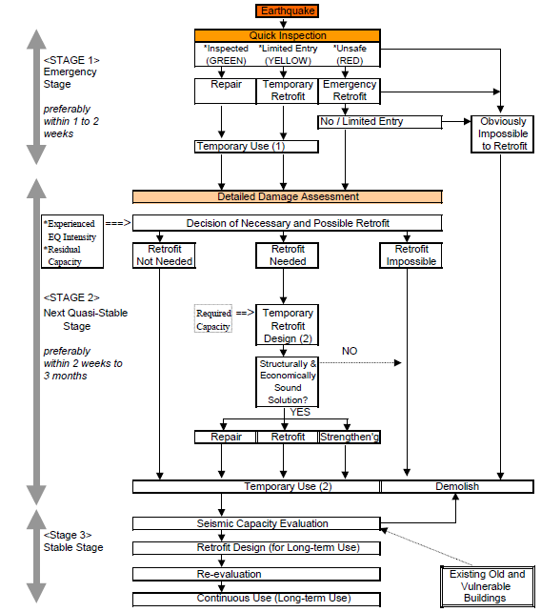

Slide 3
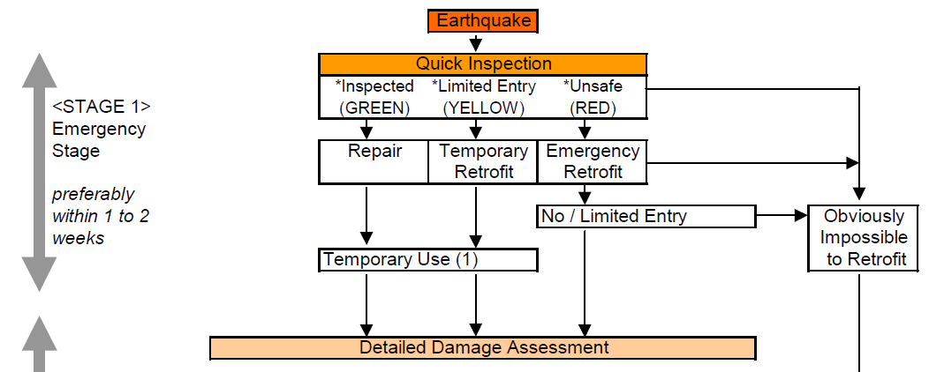
DEPREM SONRASI HIZLI DEĞERLENDİRME

Slide 4
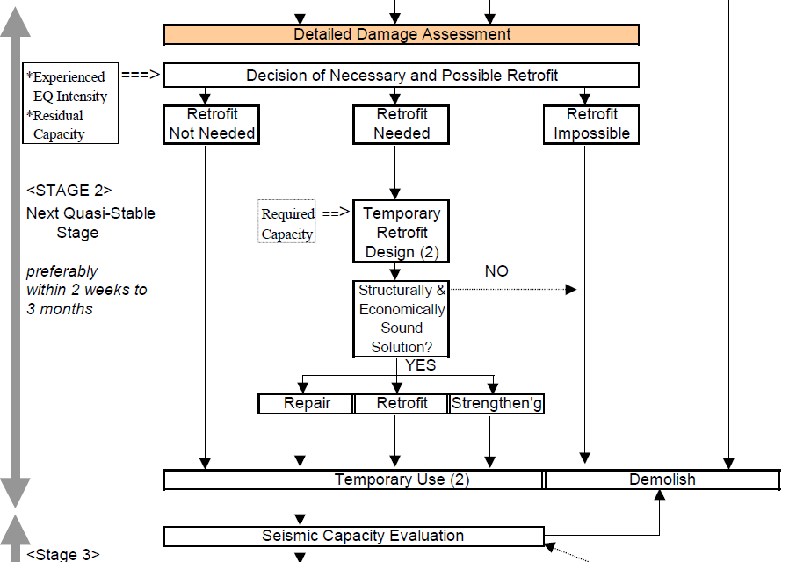
DETAYLI DEĞERLENDİRME

Slide 5
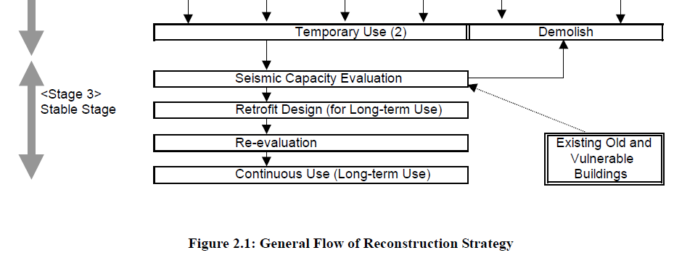
ONARIM VE GÜÇLENDİRME

Slide 6
İNCELEME ADIMLARI -1
BINA DIŞINDAN GENEL BİR DEĞERLENDİRME
Binaya girip inceleme yapılması güvenli olup olmadığı araştırılır. Uzman görüşü binaya girmek tehlikeli diyorsa bina ağır hasarlıdır.

Slide 7
İNCELEME ADIMLARI -2
TAŞIYICI ELEMANLARDA HASARLARIN TANIMLANMASI
Kritik katta inceleme yapılır
Düşey taşıyıcı elemanlarda hasar derecelendirilir:
(Jp kılavuzda kirişler dahil edilmemiş)
Kirişlerde (TDY 2007 Bölüm 7.7)

Slide 8
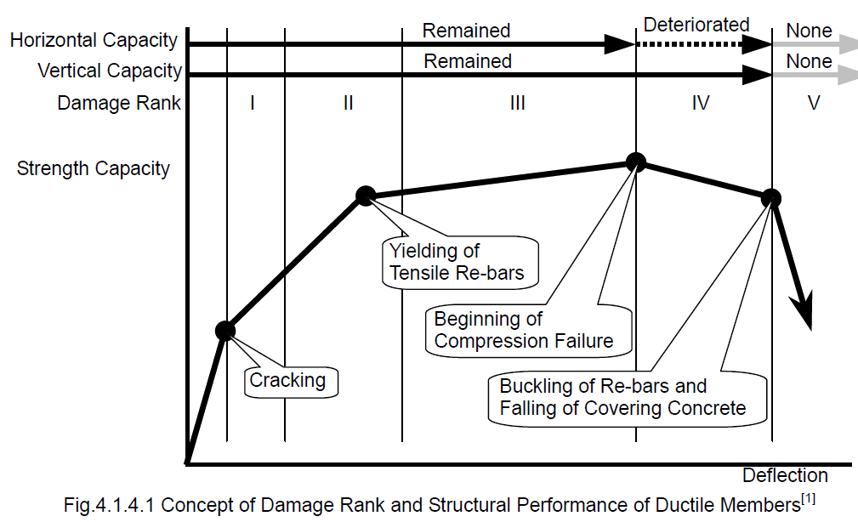
HASARLARIN TANIMLANMASI

Slide 9
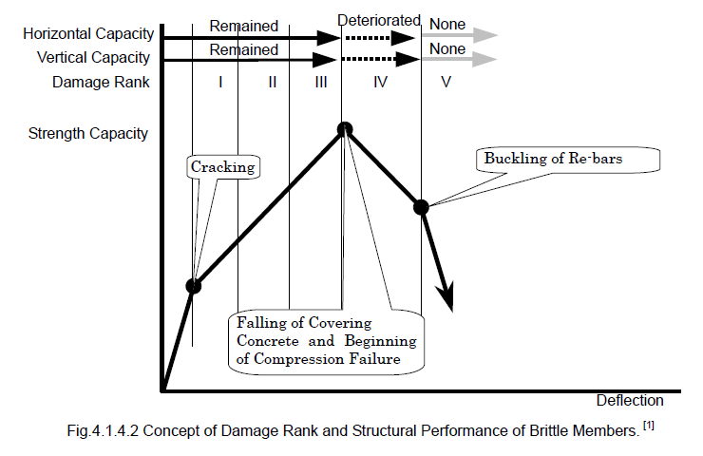
HASARLARIN TANIMLANMASI

Slide 10
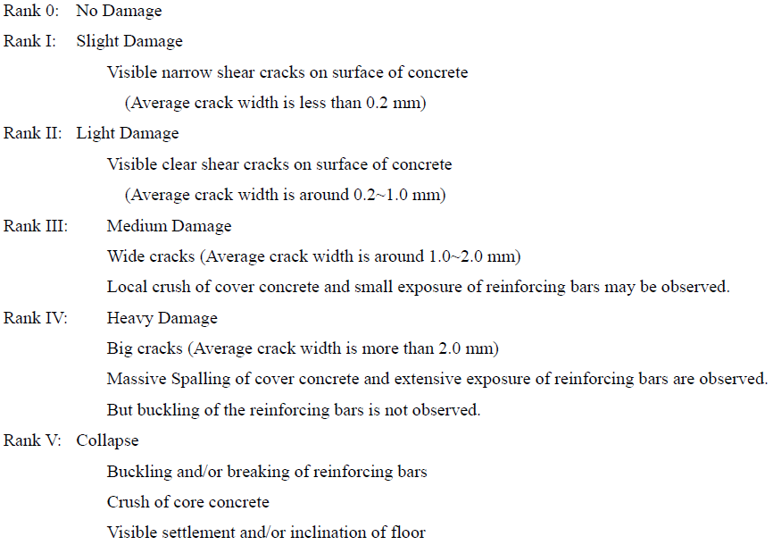
HASARLARIN TANIMLANMASI

Slide 11
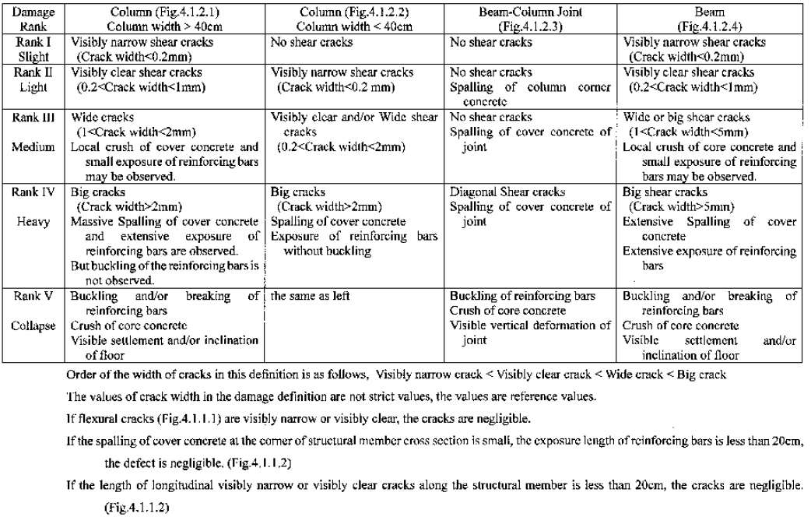
Detailed Definition of Damage Rank

Slide 12
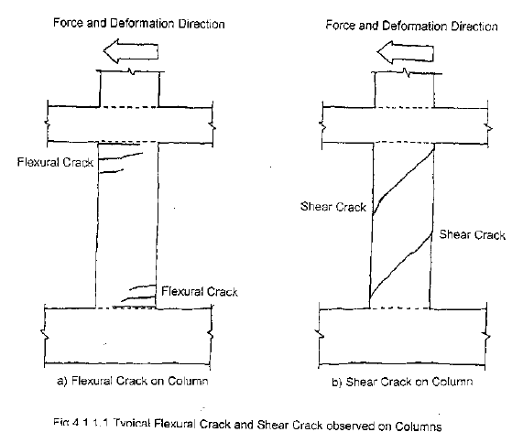
HASARLARIN TANIMLANMASI

Slide 13
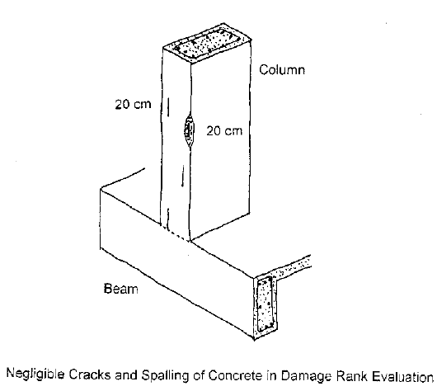
HASARLARIN TANIMLANMASI

Slide 14
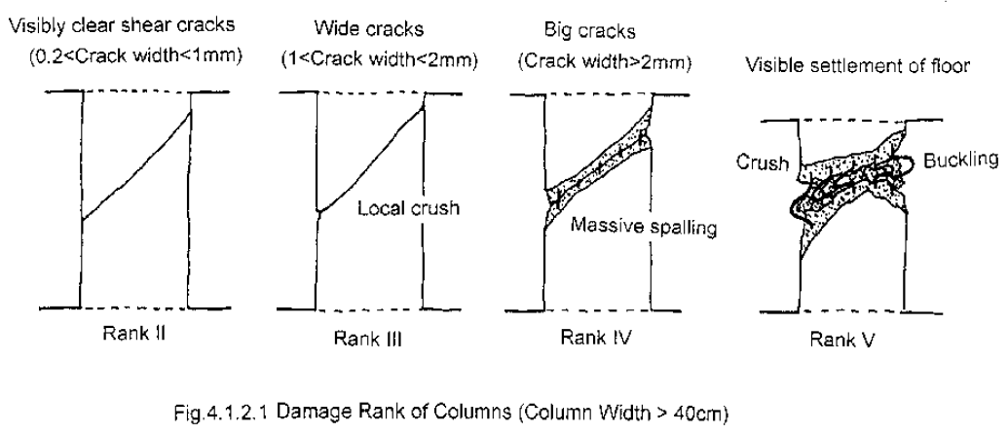
HASARLARIN TANIMLANMASI

Slide 15
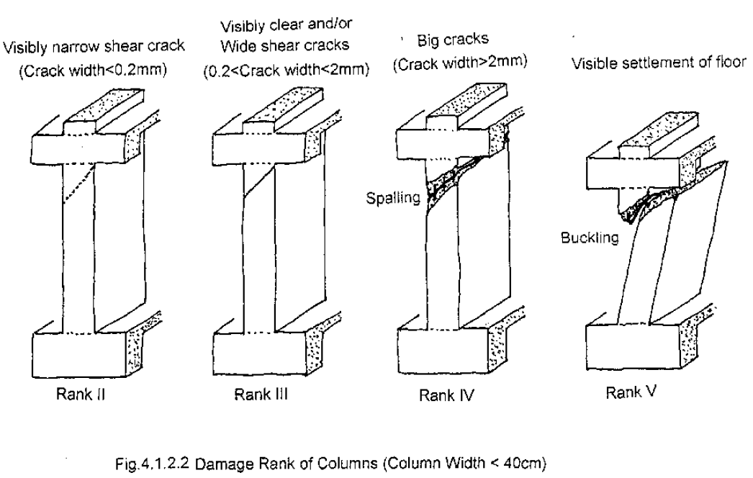
HASARLARIN TANIMLANMASI

Slide 16
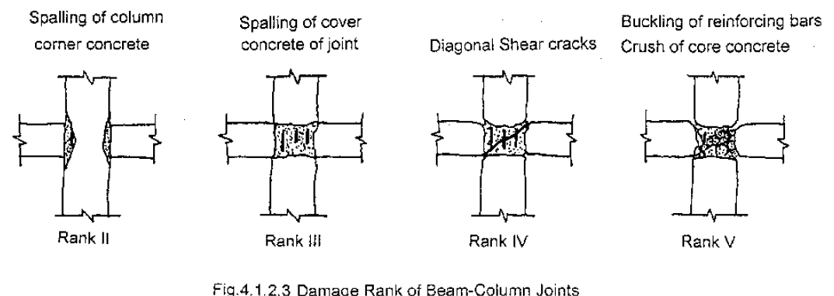
HASARLARIN TANIMLANMASI

Slide 17
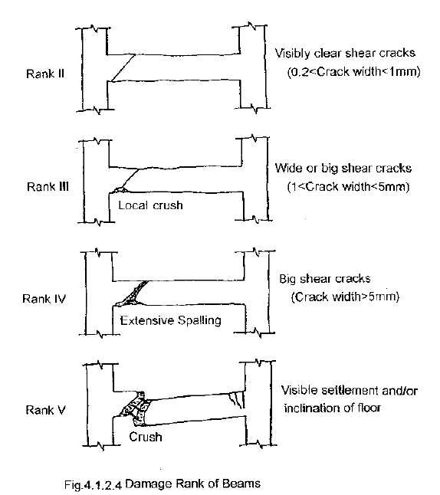
HASARLARIN TANIMLANMASI

Slide 18
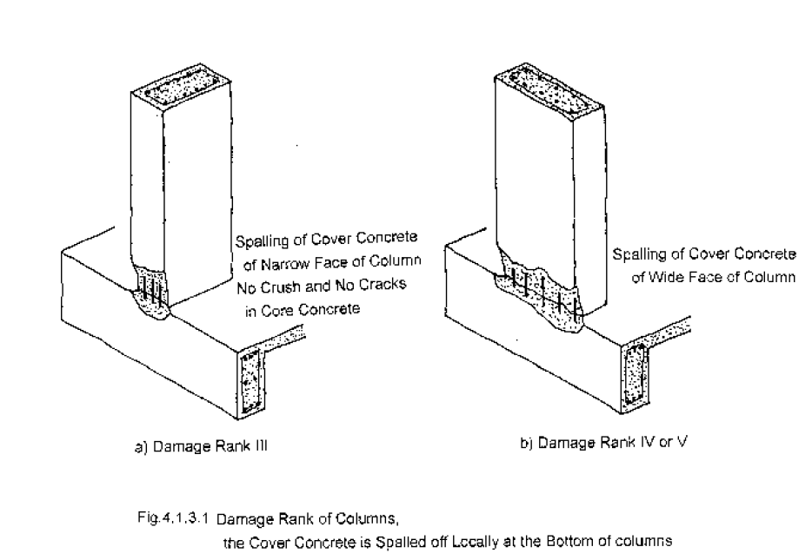
HASARLARIN TANIMLANMASI

Slide 19
Examples of Structural Damage
Damage Rank I
Visible narrow shear cracks on surface of concrete (Average crack width is less than 0.2 mm)

Slide 20
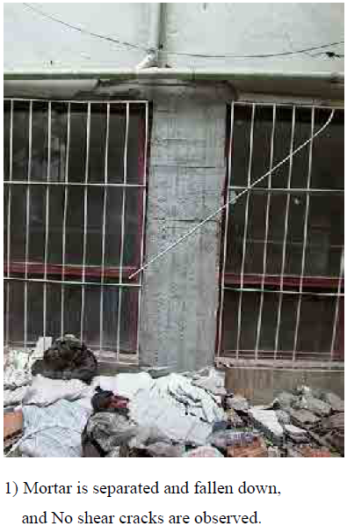
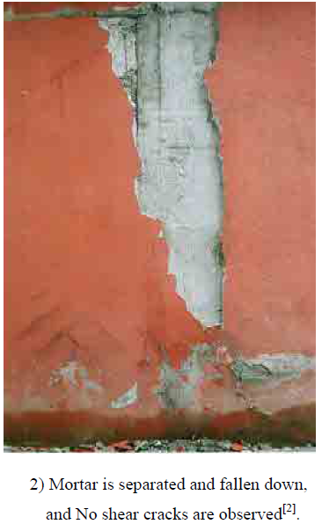
Examples of Structural Damage

Slide 21
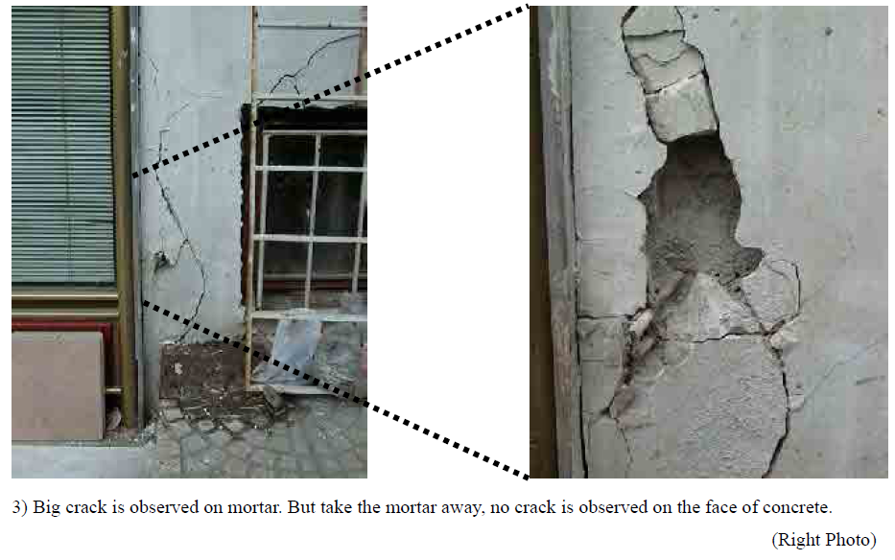
Examples of Structural Damage

Slide 22
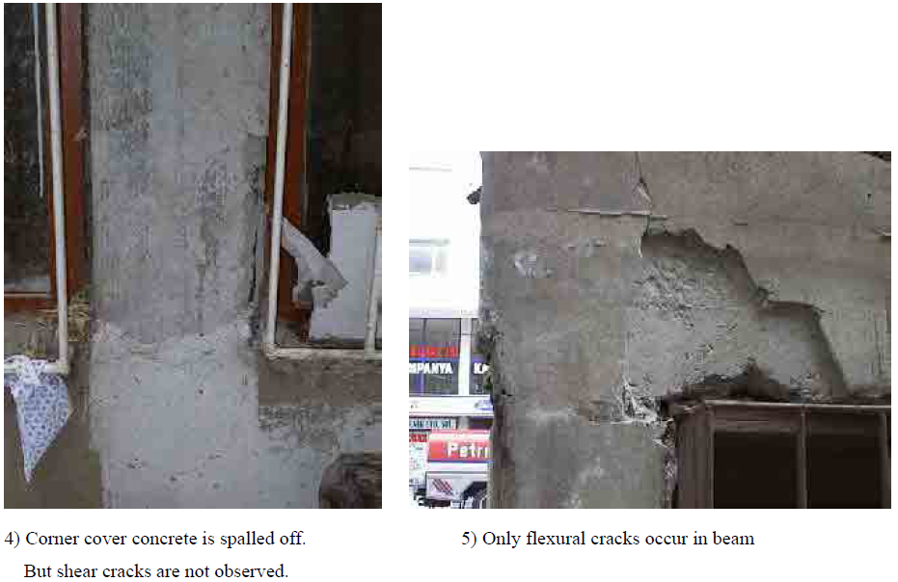
Examples of Structural Damage

Slide 23
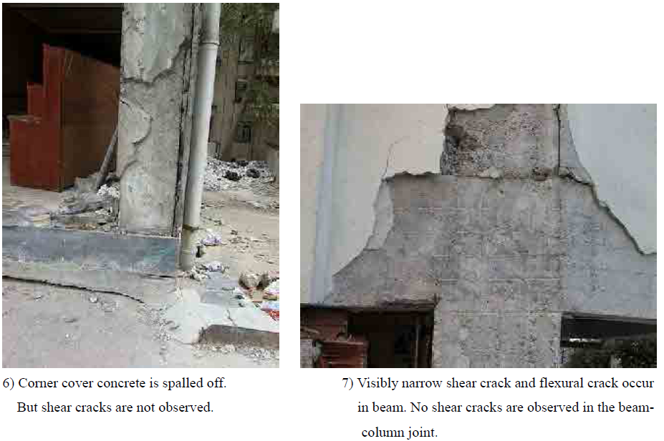
Examples of Structural Damage

Slide 24
Damage Rank II
Visible clear shear cracks on surface of concrete (Average crack width is around 0.2~1.0 mm)

Slide 25
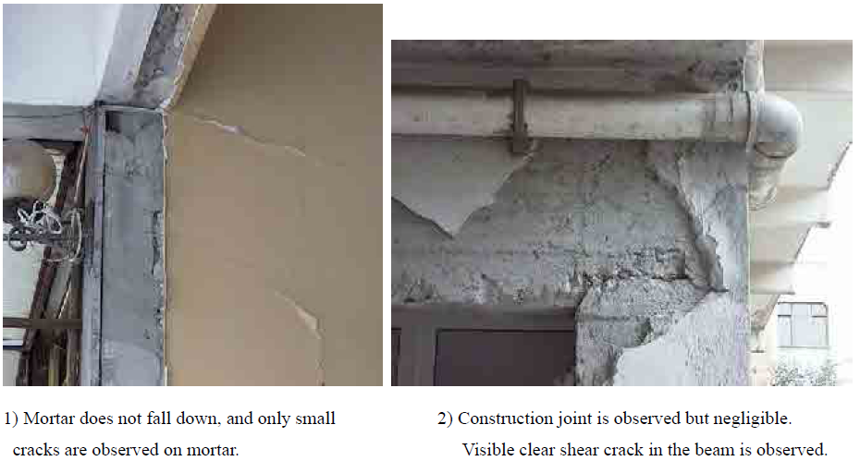
Examples of Structural Damage

Slide 26
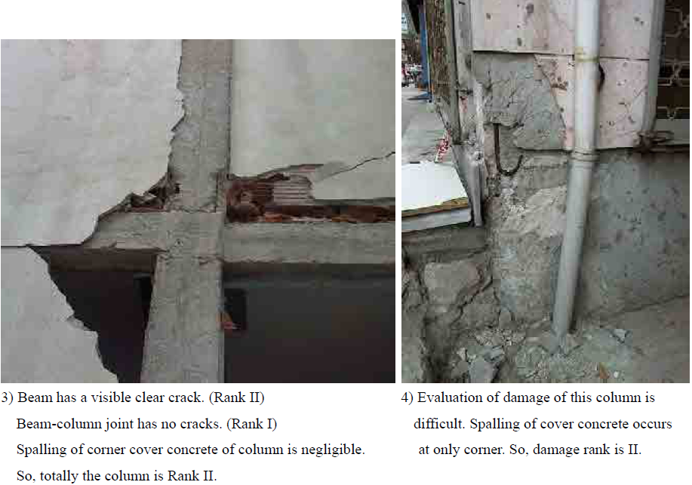
Examples of Structural Damage

Slide 27
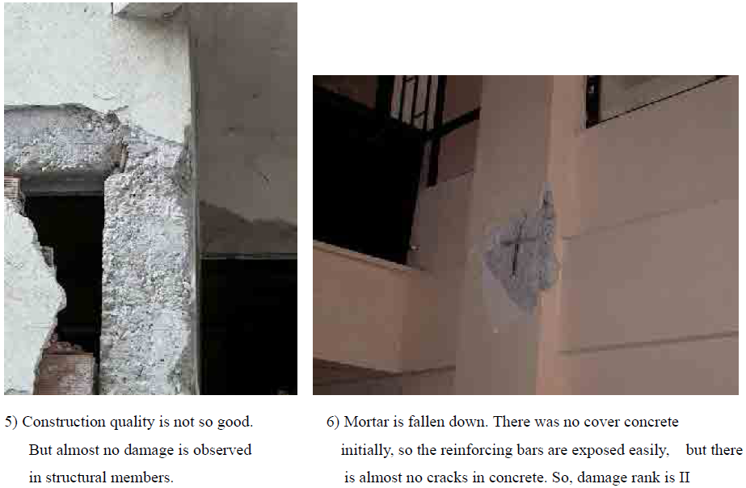
Examples of Structural Damage

Slide 28
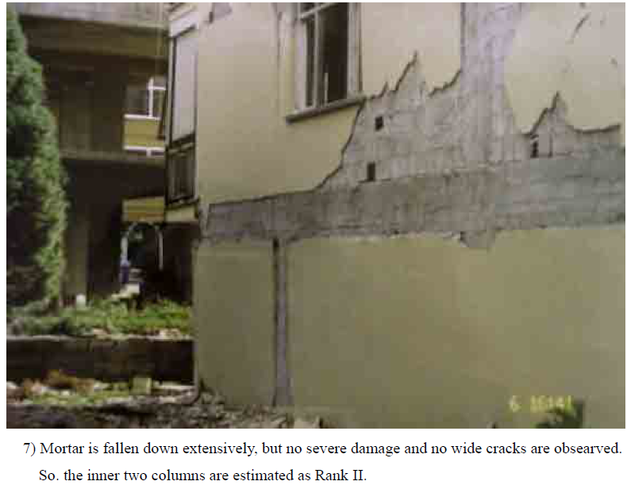
Examples of Structural Damage

Slide 29
Damage Rank III
Wide cracks (Average crack width is around 1.0~2.0 mm)
Local crush of cover concrete and small exposure of reinforcing bars may be observed.

Slide 30
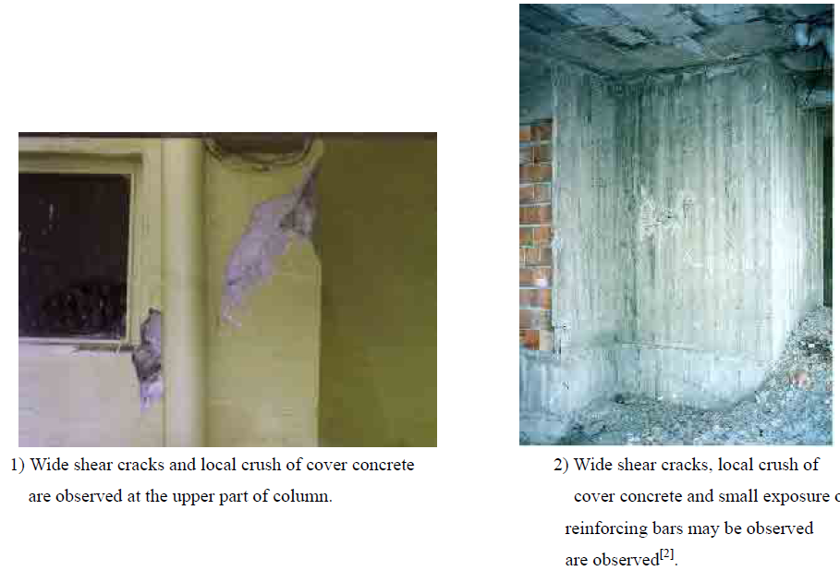
Examples of Structural Damage

Slide 31
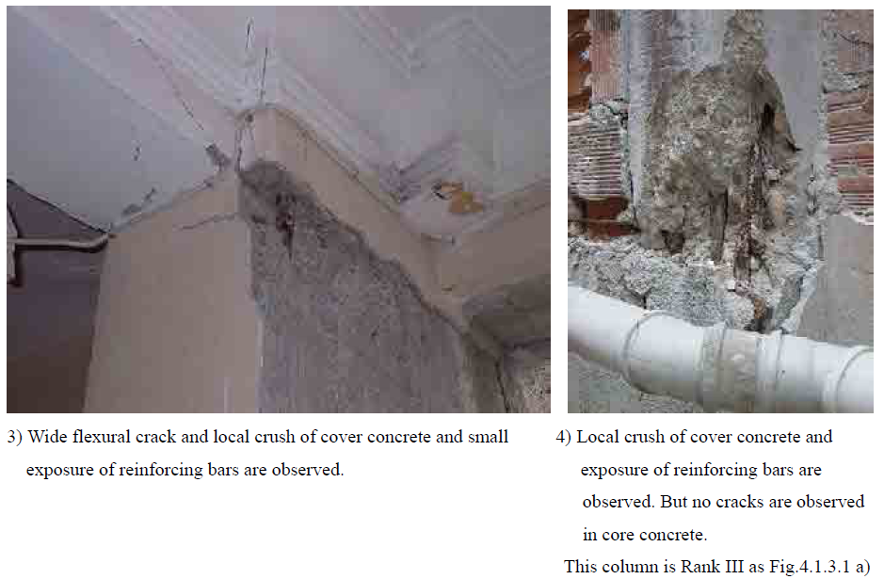
Examples of Structural Damage

Slide 32
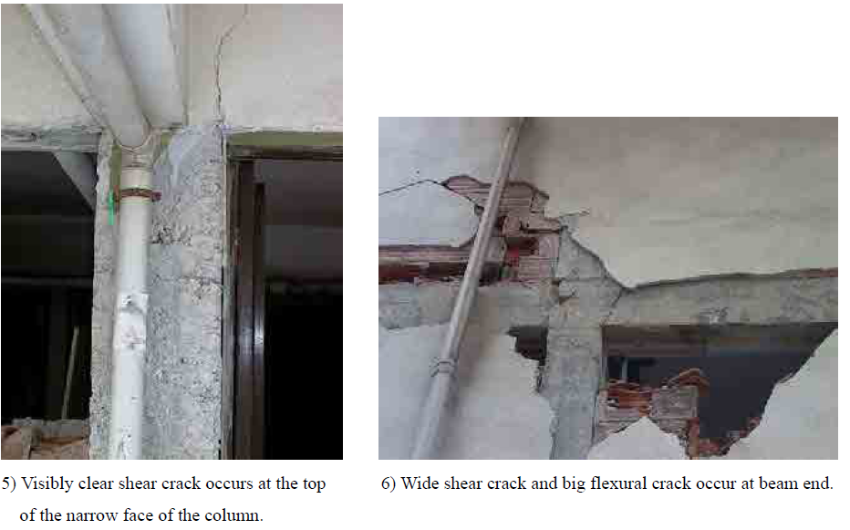
Examples of Structural Damage

Slide 33
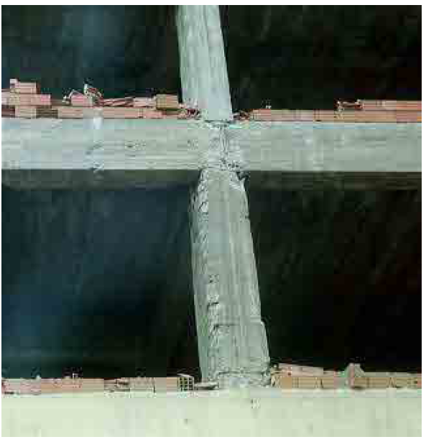
Examples of Structural Damage
7) Some corner cover concrete are spalled off in the column damage,
but damage mainly occurs beam-column joint. Cover concrete is
spalled off but no diagonal shear cracks are observed[2].

Slide 34
Damage Rank IV
Big cracks (Average crack width is more than 2.0 mm)
Massive Spalling of cover concrete and extensive exposure of reinforcing bars are observed.
But buckling of the reinforcing bars is not observed.

Slide 35
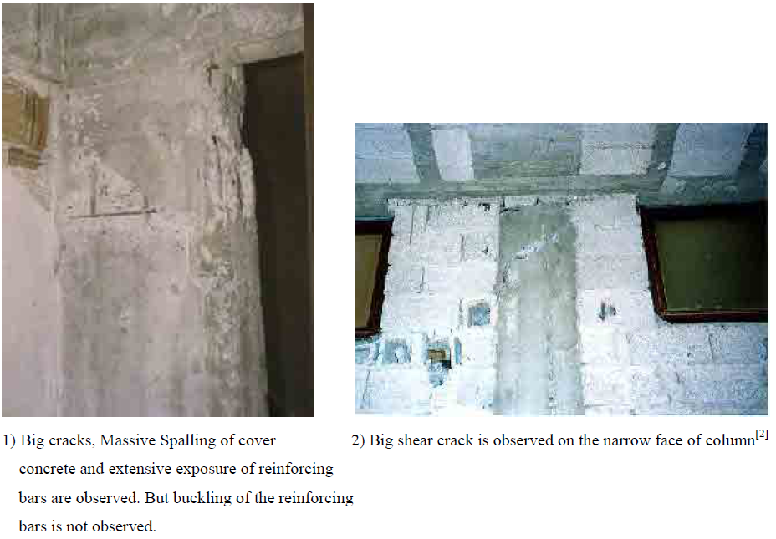
Examples of Structural Damage

Slide 36
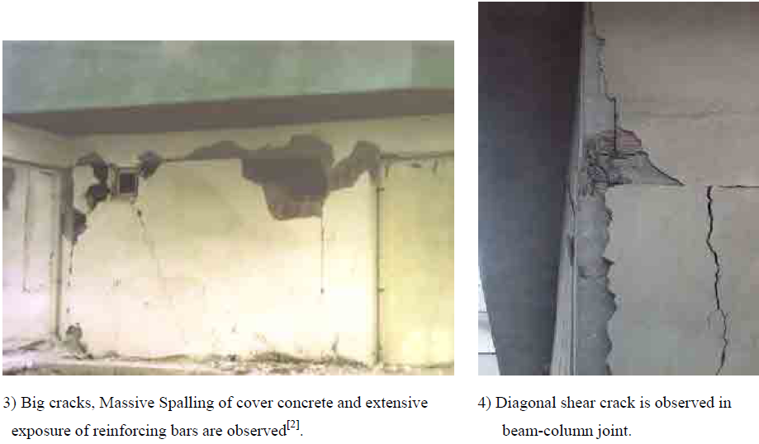
Examples of Structural Damage

Slide 37
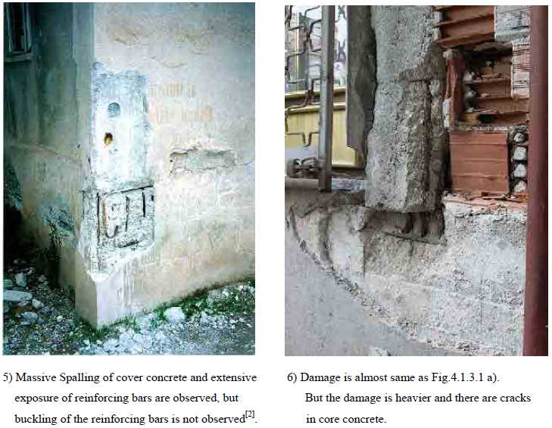
Examples of Structural Damage

Slide 38
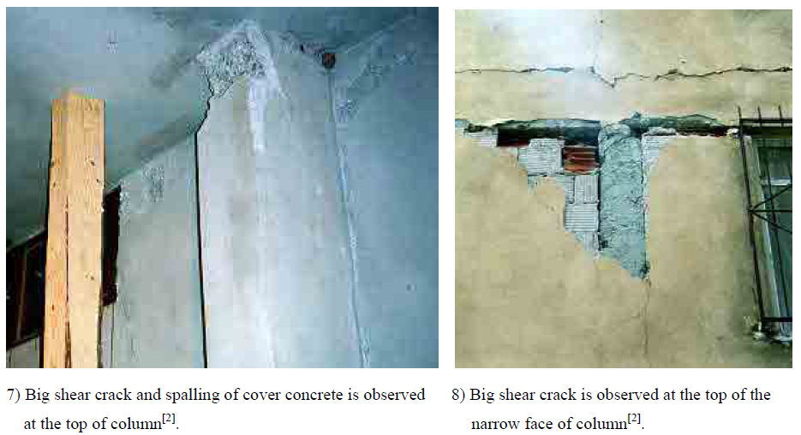
Examples of Structural Damage

Slide 39
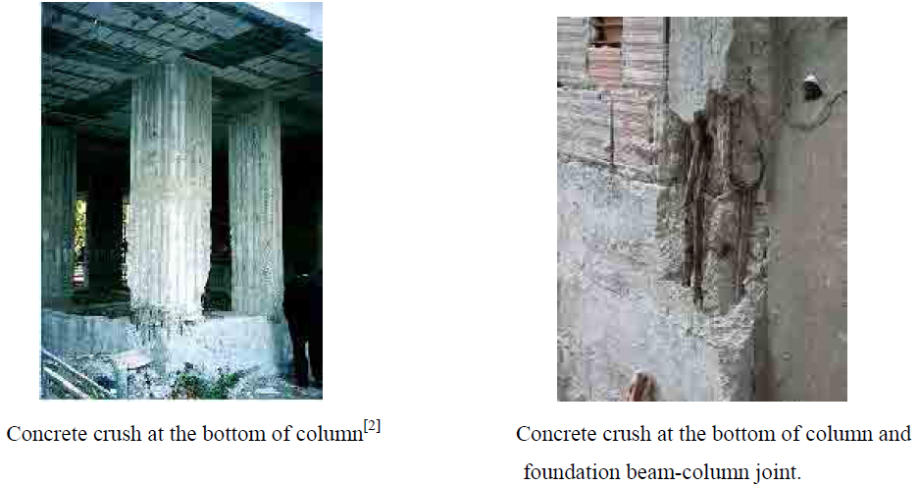
Examples of Structural Damage

Slide 40
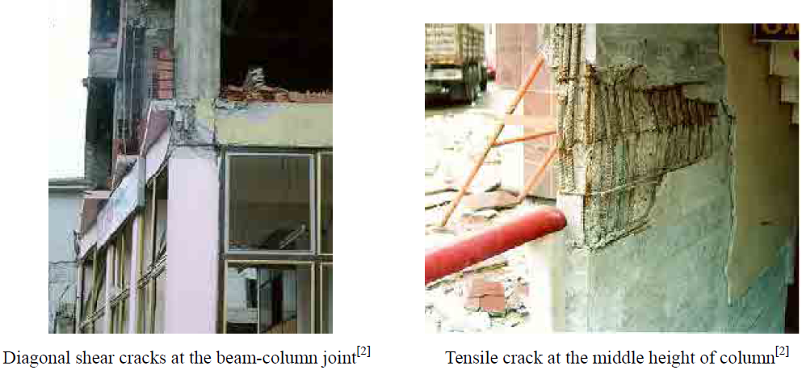
Examples of Structural Damage

Slide 41
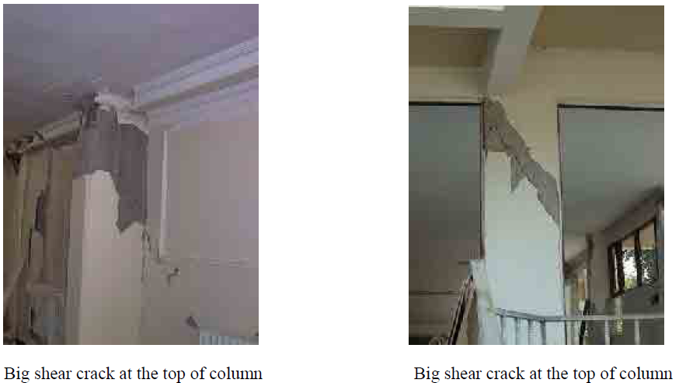
Examples of Structural Damage

Slide 42
Damage Rank V
Buckling of reinforcing bars
Crush of core concrete
Visible settlement and/or inclination of floor

Slide 43
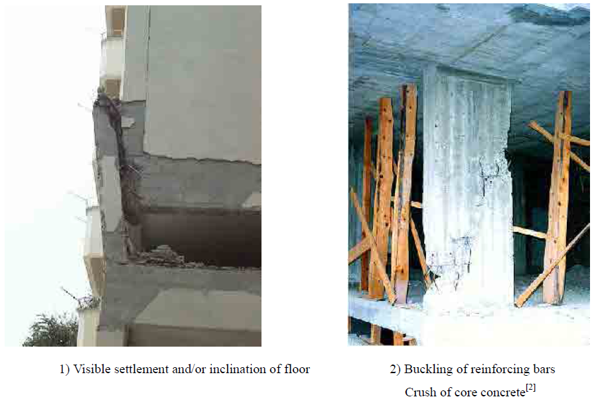
Examples of Structural Damage

Slide 44
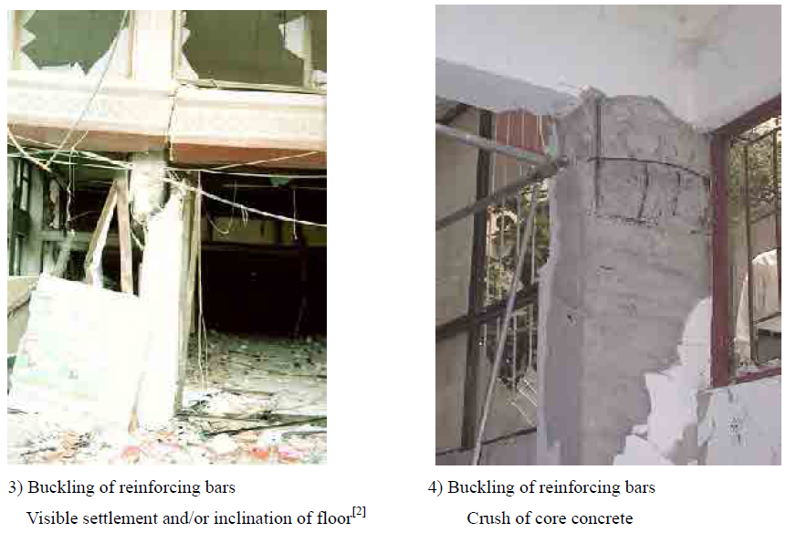
Examples of Structural Damage

Slide 45
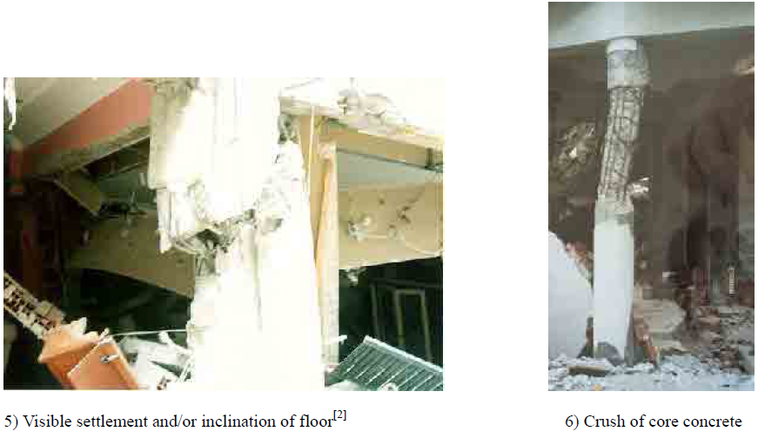
Examples of Structural Damage

Slide 46
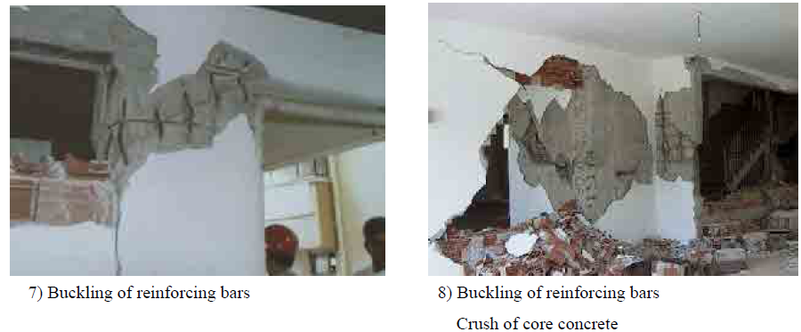
Examples of Structural Damage

Slide 47
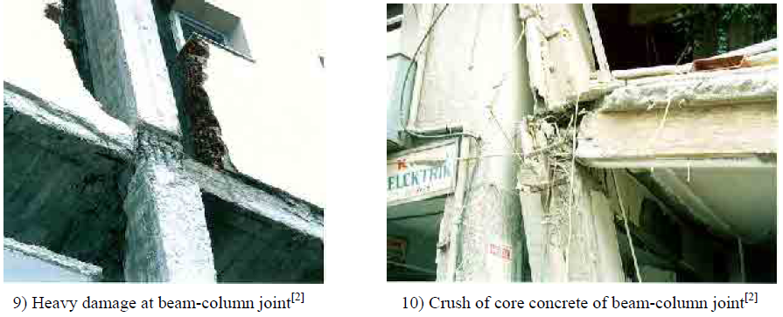
Examples of Structural Damage

Slide 48
Duvar hasarları
(Çerçeve içinde kalan)
(Çerçevesiz)

Slide 49
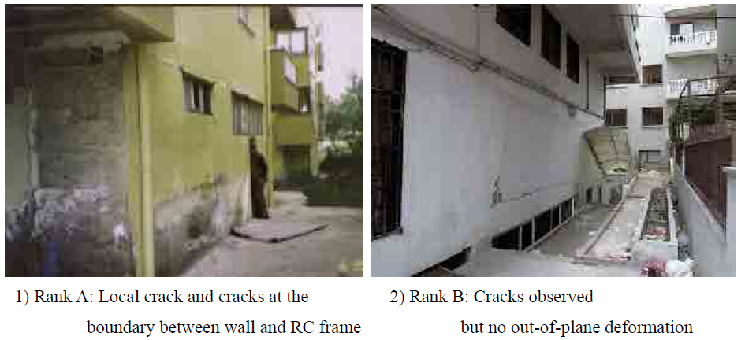
Examples of Structural Damage

Slide 50
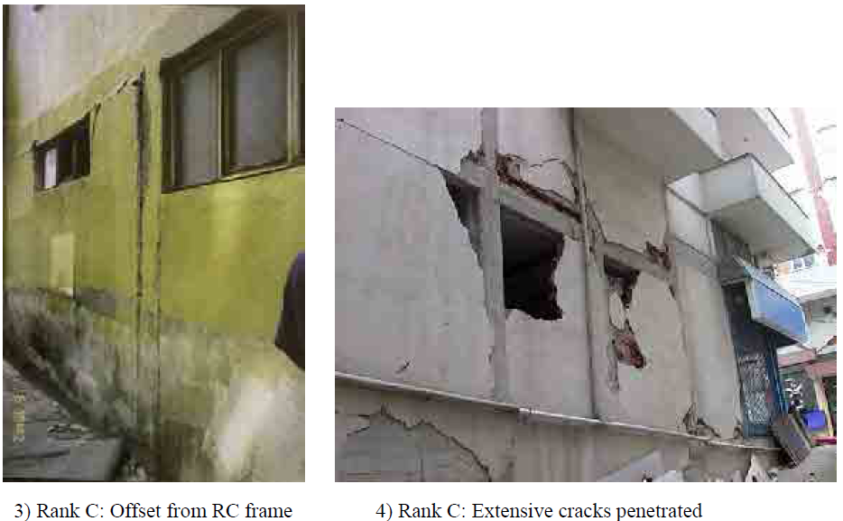
Examples of Structural Damage

Slide 51
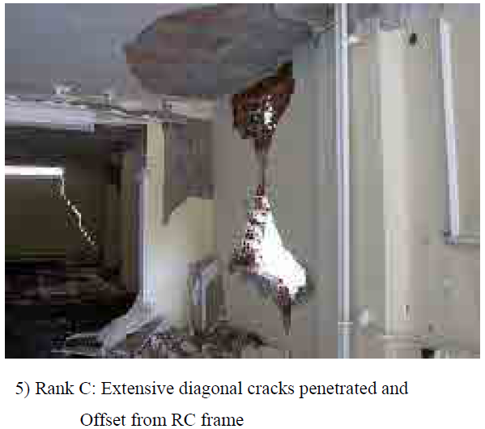
Examples of Structural Damage

Slide 52
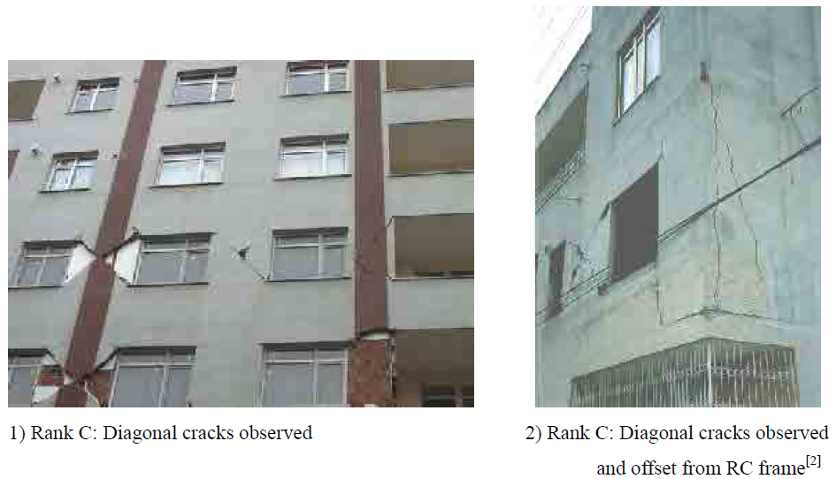
Examples of Structural Damage

Slide 53
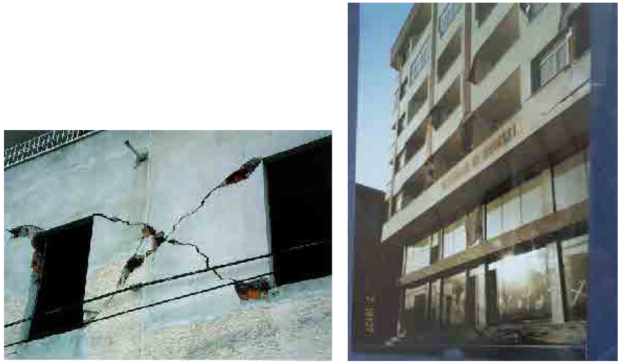
Examples of Structural Damage
4) Rank C: Diagonal cracks observed in upper stories. Keeping out is needed near the building.
3) Rank C: Diagonal cracks observed[2]

Slide 54
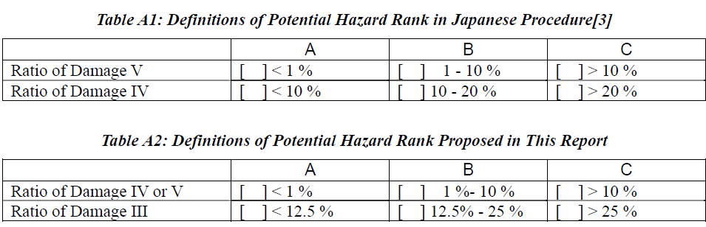

Slide 55
?

